Slide 1
The Free Energy Principle: A conceptual introduction
☺

Slide 2
Disclaimer
This is my understanding of a field that’s notoriously hard to understand
So doing my best
I will not go into math and neuroscience

Slide 3
Also,
Totally ask if something doesn’t make sense!
There’ll be time for comments and broader questions later ☺

Slide 4
Karl Friston
Creator of SPM
Background in physics and neuroscience
At University College London
Respected and controversial
Jakob Hohwy
Monash, Melbourne
Philosophy and neuroscience
Danish – and he knows Josh!

Slide 5
Ambition
Attempts to unite:
Robotics, biology, neuroscience, cognitive science, psychology, economics and social sciences in general
”The sciences of life, mind, brain and society”
Subsumes or generalizes many theories within cognitive science and biology
Reinforcement learning, expected utility theory, bayesian brain, predictive coding, self-organization, homeostasis, explore/exploit
Etc.
Based on first principles from statistical physics
Mathematically and neuroscientifically implementable

Slide 6
The basic idea
Humans (and living systems in general) is
A statistical model of its environment / the world
Which is continually updated based on feedback from the world
Not only do living things do this
It is all they do, per definition
This is general for all self-organising systems
Across spatial and temporal scales
From cells through bodies to cities and cultures
From saccades through learning to evolution

Slide 7
Awesome
But why?

Slide 8
We start from the beginning
Existence: to inhabit a narrow subset of possible states with high probability
Attractor in phase space
Surprisal: how improbable a situation is
Average over time: entropy
Life: to actively minimize surprisal over time
Reverse diffusion
To balance the dispersion from random fluctuations
And maintain a non-equilibrium steady state
Now it’s just an optimization problem
Gradient descent

Slide 9
All very nice, but
Calculating surprisal is intractable!
We would need to have acces to all possible states

Slide 10
To solve this,
Two concepts are important:
1) The Markov Blanket 2) Variational Free Energy

Slide 11
The Markov Blanket
Probabilistic definition of what constitutes a system
(Yes, it’s related to Markov Chains)
Internal/external independence
Active vs sensory states
Blankets all the way down
And up
And forwards ☺
A Markov blanket necessarily entails modelling of the world

Slide 12
Enter: Variational Free Energy
Free energy is a concept from statistical thermodynamics
Free energy = surprisal + perceptual divergence
And prediction errors = free energy
So, per the statistical definition, life entails prediciton error minimization

Slide 13
Modelling the world
The generative model
Statistical relations between different world states and sensory states
Generates predictions about sensory states
(Approximately) Bayesian
”Variational Bayes” – founded in quantum mechanics
Inversion of the generative model
Estimates causes of sensory states – i.e. the world
Called ”the recognition density” – recognizing world states
Easy in a linear world
But the same world states can generate different sensory states
And different world states can generate the same sensory states

Slide 14
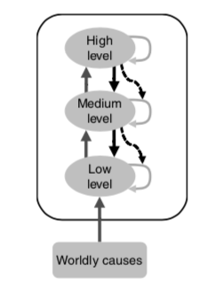
A Hiearchical Model
Different levels, different timescales
Light changes during seasons, days, the place and on a specific object
The lowest is actual sensory inputs
Each level predicts the level below it
Prediction errors propagated up through the system
The full model is distributed over many simple inversions
Which can be implemented in neurons
Gives our rich, multimodal experience
Precision weighting
Noisy input should not be used for updating
Also context-dependent, predicted from higher levels
That’s attention

Slide 15
We experience the model, not the world
This is a place where the classical cogsci account is inverted
We do not have top-down modulation of bottom-up signals
We have sensory modulation of top-down predictions
Our senses is the feedback

Slide 16
But a worry:
How do we know our models are accurate then?
How do we know they have anything to do with the world?

Slide 17
Supervised by the world: The Leaky Dam Metaphor

Slide 18
Okay. That’s half the story. But so far we have a really passive agent Something is missing

Slide 19
Action as prediciton error minimization
Advantages for inference:
Can sample more precise inputs
But also distinguish hyotheses
Active inference
To change the world to give the outputs we expect
This is reducing surprisal -> existence
Action is the fulfilment of proprioceptive predictions
Also across timescales
The system must model itself

Slide 20
A self-fulfilling prophecy? The Dark Room problem
If we change the world to fit our predictions
What’s to say we wouldn’t just do anything for that?
Why would we ever watch horror movies?
Why not just go sit in a dark room?
It’s minimization over time
We expect to learn from movies
And starving gives prediction errors
The system has priors for which states it should be in
Evolved phenotype

Slide 21
Phew. That was the main theory I’ll go briefly over some related issues ☺

Slide 22
Enactivism vs Representationalism
There has been a discussion: Does the brain represent the generative model neurologically?
Jakob Hohwy thinks it does
A new Friston article says no:
The generative model is entailed by the system’s dynamics
i.e., essentially its actions
Brain activity is subordinate to that
A system will ‘appear’ to infer the world, because if it didn’t, it wouldn’t exist
Different implementations
Our physiology also implies predictions
Evolution as Bayesian model selection

Slide 23
Falsifiability?
The theory has been criticized as infalsifiable
One can make a free energy description of anything
But it is more like a way of thinking about things
And then you can have falsfiable hypotheses under it
That is, a paradigm
This has been compared to evolution theory
The free energy principle will be evaluated on how useful it is
Much has been done in cognitive science, neuroscience and biology
But it remains to be seen if it is useful for culture
Is free energy ”real”?
No matter what, if a systems tracks and minimizes it, there willb e real physical effects: the system will keep existing

Slide 24
Variational Neuroethology
Free energy principle was combined with a broad theory for biology
An ”ecobiopsychosocial” theory
Aim is to support more specific theories within the free energy principle
Tinbergens four questions, different scales for describing the system
Real-time movements,
Development
Across-generation
Evolution
Which gives some research heuristics
Think interconnected across scales
Think hiearchically
Think in Free Energy terms

Slide 25
A note on the brain
Hiearchical organization fits well
The math is simple enough to be implemented in the brain
Softmax function: neuronal firing rates
Logarithmic transforms: nonlinear postsynaptic responses
Linear algebra: neuronal connectivity
And there are specific theories of which cells do what

Slide 26
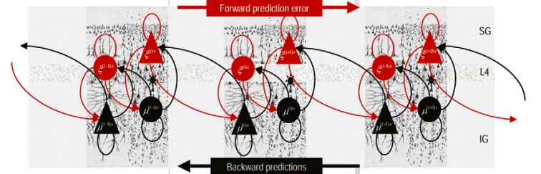

Slide 27
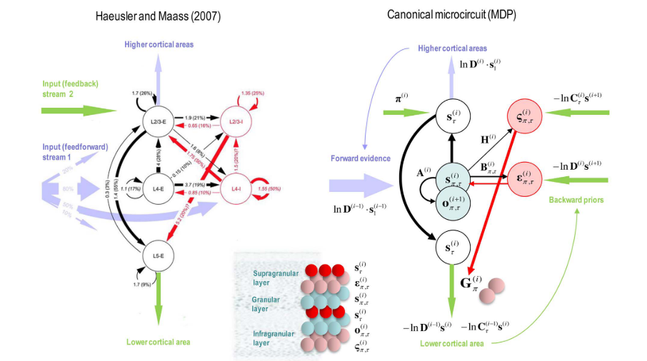

Slide 28
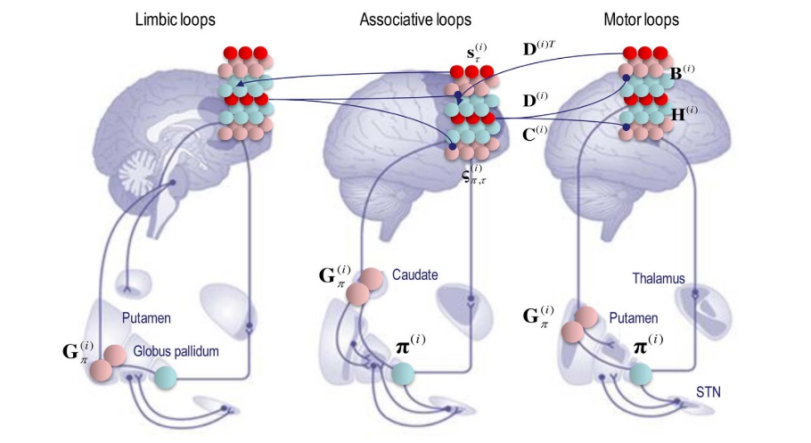

Slide 29
Some other areas
Value
It all comes down to prediciton error minimization
Explore/exploit dynamics
Learning
Hermeneutics
Abstract art
Emotions
Constructivism, emobiment
Mental ilnesses
Depression, schizophrenia, stress, autism
Related to precision weights
The social sciences
Culture – dynamics of a system
Social groups. Internet.
Consciousness.. ?
Let’s see

Slide 30
So is this cool ?
Do we even want a grand unifying theory?
A simple mechanism that explains it all
And based on first principles
Cooperation across fields
Or local and competing solutions
Promising applications

Slide 31
Now there’s time for questions! I also have an example from an article where the framework is applied We can do it if you want – Or we can stop here ☺

Slide 32
A lecture by Friston himself. Pretty nice.
Provost’s Lecture: Karl Friston on “I Am Therefore I Think”
https://www.youtube.com/watch?v=G_sQZeFRjR8

Slide 33
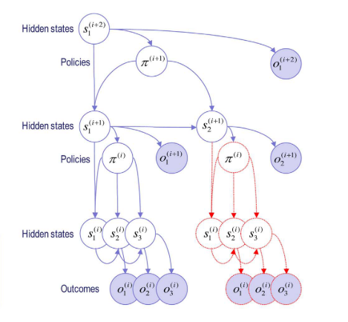
The structure of the model

Slide 34
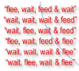
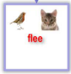
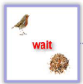
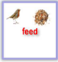
A simulation of reading
With a few possible sentences
And toy ”words” and ”letter”s

Slide 35
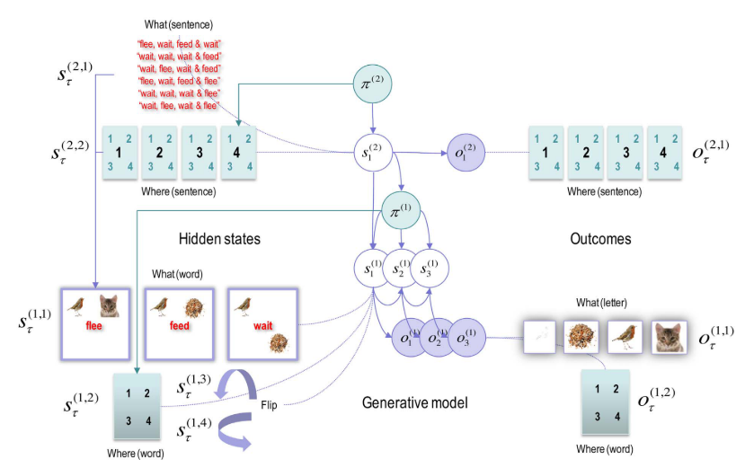

Slide 36
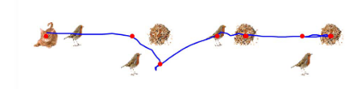
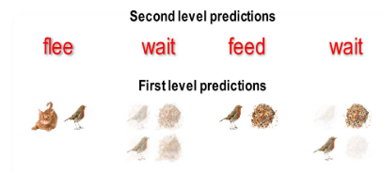
Behavioural results
Eye movements
And predictions

Slide 37
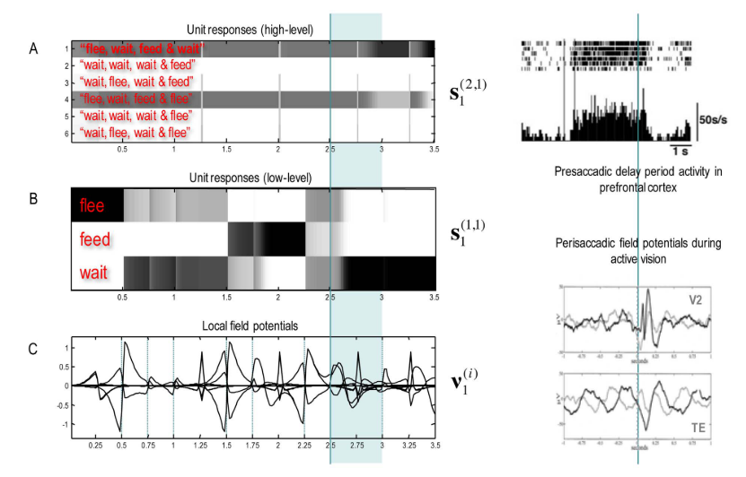

Slide 38
